Slide 1

RO-Workshop
Issuing the qualified certificate
xIDENTITY
Christoph Klein

Slide 2



A-TRUST stands for…
Trust
Focused on trust, integrity and comfort
Core business: creation of safe signatures
Experience
Active on the Austrian market since 2000, German subsidiary since 2019
Accredited certification service provider since 2002, qualified trust service provider according to eIDAS since 2016
Leading trust service provider in Austria
Success
Significantly involved in the digitalization of Austria, in close cooperation with ministries: Handy-Signatur & ID Austria
Over 3.6 million ID Austria users & former Handy-Signatur users
Market leadership in the area of cash register certificates (in AT)

Slide 3






A-Trust in numbers
4 Mio.
Active qualified certificates
4.000+
Integrations
~80%
Market share RKSV
20+
Years of expertise in the certificate sector
10 Mio.
Signatures per month
1.5 Mio.+
Documents signed via A-Trust p.A.

Slide 4

A-Trust in numbers
2.000+
partners
Company founded in Austria
Year
2000
2019
Company founded in germany
36
A-Trust experts
Year
100% austrian owners

Slide 5

Overview

Slide 6

Digital signature (~1997)
Secure authentication of individuals
Verifiable and binding documents (contracts)
Secure technical procedure
Cost-efficient technology for applications
Avoidance of transaction-based costs
Complies with European & Austrian signature law
Under the supervision of Rundfunk und Telekom Regulierungs-GmbH (implemented by RTR-GmbH)

Slide 7
Glossary
Qualified certificate
ECC - elliptic-curve cryptography
LDAP / CRL / OCSP – Checking the certificate status
Widerrufspasswort
CIN - Contract number
VDA – Trust service provider
RO / zRO
RA-ID

Slide 8

Cybercrime
Problem: Usability is promoted without regard for security
Threats
    Phishing
    Man in the Middle
    Trojans (Viruses)‏
Damage in Europe already in the billions
Unsettled customers/users

Slide 9

Phishing
Users are persuaded to disclose one or more TANs with fictitious justifications, which are then used by the perpetrators.
Users of qualified signatures are protected against such an attack by more than one component:
  Transaction authorization using qualified signatures in the two-factor process
  No transaction can be carried out without authority over the second factor‏

Slide 10
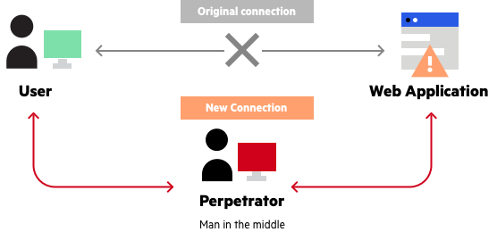
Man in the Middle
The most common form concerns TAN variants (TAN, iTAN, TAN generators, etc.);
Transaction carried out correctly by user:in is manipulated
The qualified signature and its technical procedures prevent misuse of:
  Data modification by the cryptographic process (hashing) is excluded.
  The signature can no longer be displayed as valid after manipulation.

Slide 11

Trojans/viruses
Software component that is installed on a PC unnoticed by the user
Spies on authorization data and transmits it to a third-party system (manipulation of installed software is also possible).
The creation of qualified signatures reduces the risk through the following elements:
  Signature creation data in web application
  Hash value calculation and signature in A-Trust data center
  Second factor on another device (app, SMS TAN, FIDO token, signature card)
  The functionality of the display software (Secure Viewer) displays the signed data both before and after the signing process).

Slide 12

Criticism of information exchange via the Internet
Data is read without authorization
Information is forged or falsified
The sender can deny having sent a message
The sender of a message cannot be determined

Slide 13

Benefits of digital sinatures
Confidentiality
  Keep it a secret!
  Encryption
Data integrity
      Do not change my data!
      Digital signature
Authentification
  Who are you?
  Digital signature
Non-repudiation
      Keep your promises!
      Digital signature
Transparency
  You can prove that someone has logged in

Slide 14

TECHNOLOGY

Slide 15
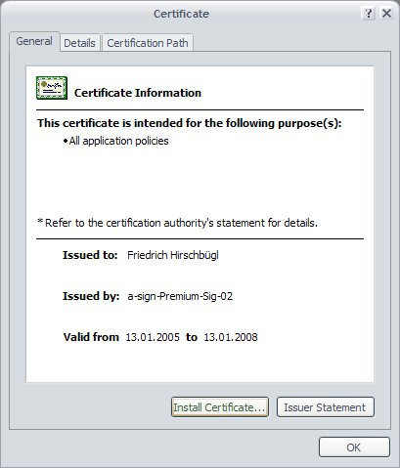
The digital certificate
an electronic document digitally signed by the person issuing it
a holding on to an identity
a reference for technical information
Application guidelines or requirements
a declaration of admissibility of the areas of application
the verification key of the signature key

Slide 16
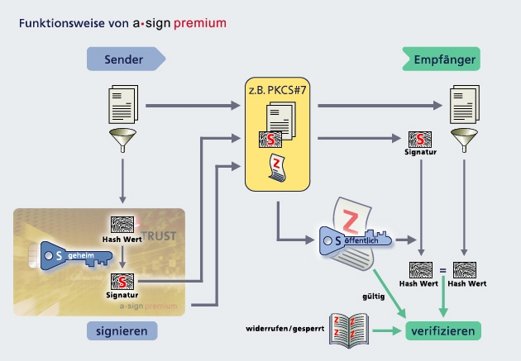
How digital signatures work

Slide 17
Services provided by the Trust Center
Registration:
  A-Trust sales offices
  Identification & instruction of the signator
  Personal handover of cards, if applicable
HSM or card:
  Key generation
Certification:
  Data center
  Certificate generation and management
  Qualified electronic signature from A-trust
  Certification management
Withdrawal service:
  Blocking and revocation of certificates
  24/7 accessibility
  Free of charge
Call Center:
  Paid support
Directory service:
  Public Internet database
  All certificates can be verified
  Validity status of the certificate is accessible 24/7

Slide 18

LEGAL

Slide 19

Qualified Signature allows
Best possible technical security
  Through a secure signature creation device that is operated independently from the PC
Best possible legal security
  Based on the eIDAS Regulation and the Austrian Signature and Trust Services Act

Slide 20
Certificates via EU-Identity Mobile/xIDENTITY
Certificate
  Signature certificate (qualified)
  A minimum of 6 digits as a signature password
Content
  Name (including title)
  No birth date (only if the signatory is not yet of legal age)
  No pseudonym possible
Storage of the key:
  in the high-security sector at A-Trust

Slide 21
Handling
Signature password
  Can consist of numbers and letters
  Case Sensitive
No possibility of resetting
  The signature can be reissued if lost
  Password cannot be reset or unlocked
  Only the signatory personally knows this password!

Slide 22

Certificate validity
Validity of the certificate:
  5 years from the date of issue
  or until the certificate is revoked or blocked.
Reissue (extension) is possible before expiry
a new certificate must be applied for after expiry

Slide 23
Austrian Handy-Signatur/ID Austria
The ID Austria is offered in Austria
Pilot operation until 05.12.2023, since then only ID Austria
Differences:
  Activation only possible in public authorities
  Connection with Austrian register of residence
  Für E-Government Applikationen erforderlich
Qualified signatures with xIDENTITY are legally equal

Slide 24

Activation

Slide 25


Activation types
Online-Activation
Registration office
Signator carries out process independently
Web-Authentification:
Web-ID
Authada
ID Now
Certificate can be used immediately
Customer is personally present at a RO
Authentification:
through Registration Officer (RO)
Official photo ID (original document)
Duration: about 10 minutes
Duration of technical procedure: about 3 minutes

Slide 26

Preparation RO Activation
Internetbrowser
Network connection
Smart Phone (RO and Signatory) - Reception!
Printer (optional for signature contract)

Slide 27
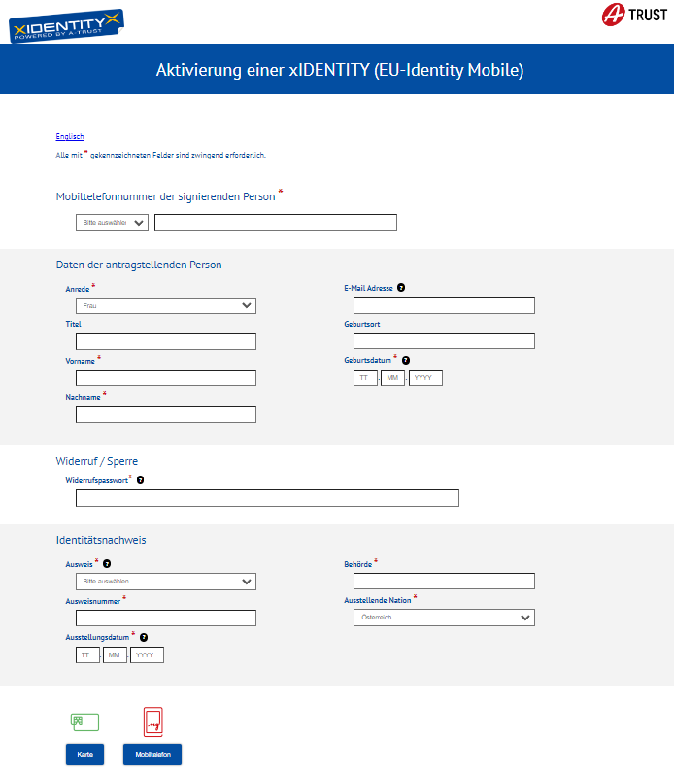
Data entry
https://www.a-trust.at/aktivierung/euidentity
Telephone number of the customer!
1:1 according to the ID card!
Minimum age: 14 years old
IDs according to the list.

Slide 28

Requirements for qualified certificates
Signatory has reached the age of 14
No active signature under the cell phone number, otherwise the previous signature will be revoked or replaced.
! Also applies to the cell Handy-Signatur or ID Austria Basic

Slide 29
Granting of RO rights
by zRO via e-mail to zro-support@a-trust.at
  Filled out document template
  Enclose a current criminal record extract or certificate of good conduct
Person must have been trained in the last year
Feedback after installation
Rights are bound to certificate -> new message when certificate is exchanged

Slide 30
Briefing
"Rules of conduct" for the signatory
To go through during activation
Online on the A-Trust Website
  https://www.a-trust.at/de/support/Downloads/Unterrichtung/eu-identity-mobile/#downloads
By confirming the signature agreement, the signatory confirms that the information has been provided
-> go through the instruction .pdf

Slide 31
FAQ
Why do I see that my PIN, TAN or telephone number is incorrect?
Indicates that either the telephone number, the signature pin or the TAN is incorrect
Why is "RO has no authorization" displayed?
If an RO reissues his or her signature, a new signature contract is created and the authorization becomes invalid. A new registration by the zRO is necessary
What can I do if the TAN/SMS is not received?
As soon as the input screen for the TAN/activation code appears, the TAN has been successfully sent by us. In this case, the customer's mobile operator must be contacted, but we have the option of storing a numeric sender and sending test messages.

Slide 32

Thank you for your attention!

